Slide 1
CLIENT SERVER ARCHITECTURE

Slide 2
CLIENT
A “CLIENT” REFERS TO A COMPUTER OR DEVICE THAT REQUESTS AND RECEIVES SERVICES, REOURCES, OR INFORMATION FROM ANOTHER COMPUTER OR DEVICE CALLED THE “ SERVER”. THIS ARCHITECTURE IS A COMMON MODEL FOR ORGANIZING AND DISTRIBUTING COMPUTING TASKS AND RESPONSIBILITIES IN A NETWORKED ENVIRONMENT.

Slide 3
THE CLIENT IS TYPICALLY A USER’S COMPUTER DEVICE, OR APLLICATION THAT INITIATES REQUESTS FOR SPECIFIC SERVICES OR DATA.
CLIENTS ARE RESPONSIBLE FOR MAKING REQUESTS TO THE SERVER, PROCESSING THE RESPONSES, AND PRESENTING THE INFORMATION TO THE USER.
THEY CAN BE DESKTOP COMPUTERS, LAPTOPS, SMARTPHONES, TABLETS , OR EVEN IoT DEVICES THAT INTERACT WITH SERVERS OVER A NETWORK.

Slide 4
SERVER
THE SERVER IS A SPECIALIZED COMPUTER OR DEVICE THAT PROVIDES SERVICES, RESOURCES, OR DATA TO CLIENTS.
SERVERS ARE DESIGNED TO LISTEN FOR INCOMING CLIENT REQUESTS, PROCESS THOSE REQUESTS, AND THEN RESPONSE WITH REQUESTED INFORMATION OR SERVICES.
EXAMPLES OF SERVER TYPES INCLUDE WEB SERVERS(DELIVERING WEB PAGES), FILE SERVERS, EMAIL SERVERS, DATABASE SERVERS(STORING AND MANAGIN DATA).

Slide 5

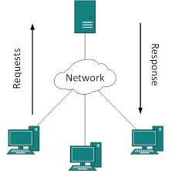
CLIENT SERVER MODEL

Slide 6
URL: - UNIFORM RESOURCE LOCATOR
EXAMPLE: - www.google.com
HTTP: - HYPER TEXT TRANSFER PROTOCOL
HTTPS: - HYPER TEXT TRANSFER PROTOCOL SECURE
EXAMPLE: - http://www.google.com
EXAMPLE: - https://www.google.com
HTML , CSS & JAVASCRIPT : THESE ARE THE CORE TECHNOLOGIES USED TO CREATE AND DESIGN WEB PAGES.

Slide 7
THREE PILLERS OF WEB DEVELOPMENT
HTML(HYPER TEXT MARKUP LANGUAGE) : - DEFINES THE STRUCTURE AND CONTENT OF WEB PAGES USING TAGS.
CSS (CASCADING STYLE SHEET): - CONTROLS THE VISUAL APPEARANCE AND LAYOUT OF WEB PAGE.
JAVASCRIPT:- ADDS INTERACT
ADDS INTERACTIVITY AND DYNAMIC BEHAVIOR TO WEB PAGES

Slide 8
INTERNET
WEB PAGES:- WEB PAGES ARE INDIVIDUAL DOCUMENTS CONTAINING CONTENT SUCH AS TEXT, IMAGES, VIDEOS, AND LINKS.THESE PAGES ARE WHAT YOU SEE WHEN YOU VISIT A WEBSITE.
WEBSITES:- IT IS A COLLECTION OF RELATED WEB PAGES ORGANIZED UNDER A COMMON DOMAIN(WEB ADDRESS). WEBSITES CAN SERVE VARIOUS PURPOSES, INCLUDING PROVIDING INFORMATION, OFFERING SERVICES.
WEB BROWSERS:- WEB BROWSERS ARE SOFTWARE APPLICATIONS THAT ALLOW USERS TO ACCESS AND VIEW CONTENT.COMMON BROWSERS INCLUDE GOOGLE CHROME, MOZILLA FIREFOX ETC…

Slide 9
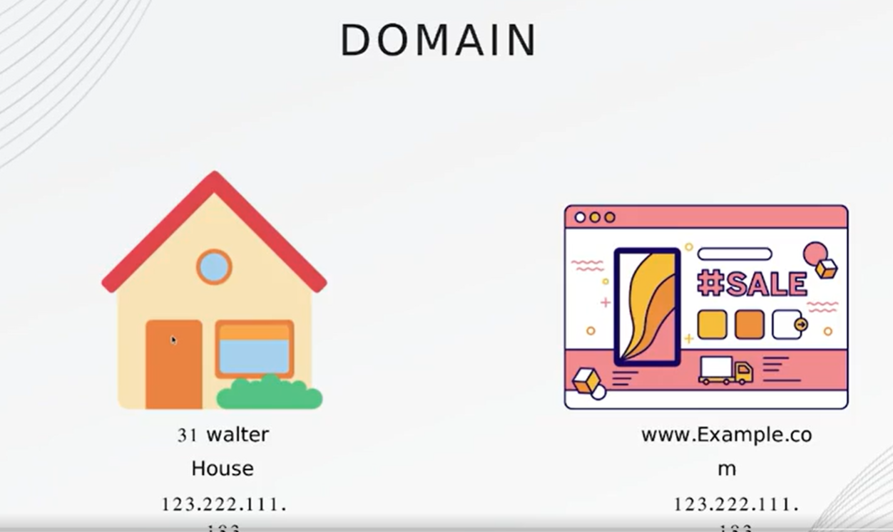
WHAT IS DOMAIN?

Slide 10
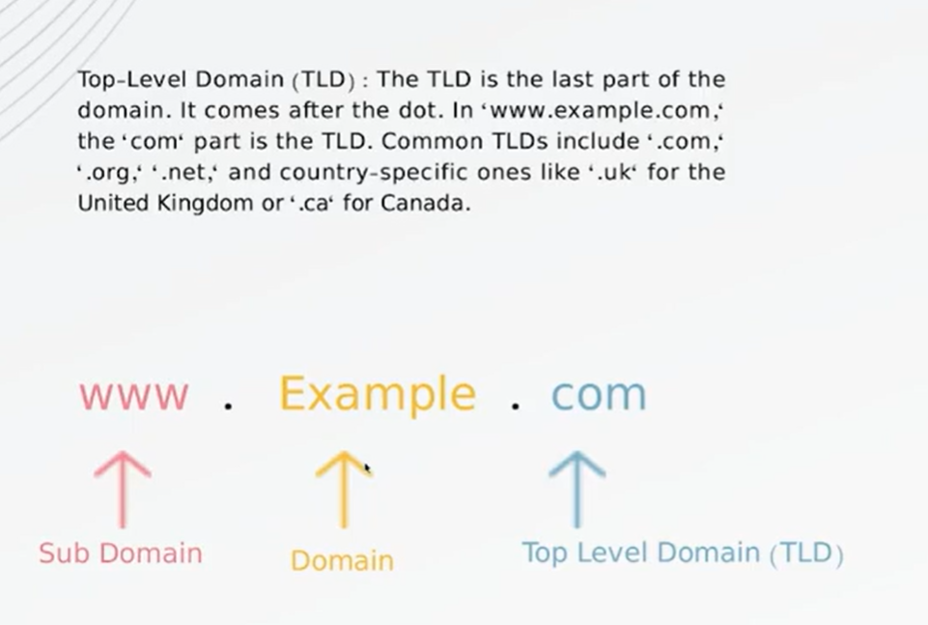

Slide 11
